Slide 1
Diabetic Retinopathy Prediction using Retina

Slide 2
Content
Abstract
Introduction
Problem statement
Existing System
Goals/Objectives
Proposed system
System Architecture
Modules
Advantages of Proposed System
Applications
Mathematical Model
Algorithm
System Requirements
Function Requirements
UML Diagrams
NP Problem
Conclusion
References

Slide 3
Abstract
Diabetic retinopathy is an eye abnormality caused by long term diabetes and it is the most common cause of blindness before the age of 50. Microaneurysms resulting from leakage from retinal blood vessels, are early indicators of DR, yielding a large body of diagnostic work focused on automatic detection of MA.
However, automated detection of diabetes is difficult because the small size of MA lesions and low contrast between the lesion and its retinal background, the large variations in color, brightness and contrast of fundus images, and the high prevalence of false positives in regions with similar intensity values such as blood vessels, noises and non-homogenous background.
In this system, we analyzed diabetes detectability from retinal images in the Diabetic Retinopathy Database - Calibration Level Raw pixel intensities of extracted patches served directly as inputs into the following classifiers: CNN.

Slide 4
Introduction
Diabetic Retinopathy (DR) is a progressive disease with almost no early symptoms of vision impairment, which is the leading cause of blindness prior to the age of 50 [2, 3]. The first detectable sign of DR is the presence of microaneurysms (MAs), which result from leakage of tiny blood vessels in the retina and manifest themselves as small red circular spots on the surface of retinas.
Early detection of diabetes is critical for diagnosis and treatment of DR, which has led to a great deal of research towards automatic detection of MAs.
Our goal is to determine whether traditional machine learning methods can achieve similar or better performance on the same retinal image dataset by exploring the full context of the image information, especially when the size of the dataset may be too limited for reliably training deep learning networks.

Slide 5
Problem Statement
Automatic diagnosis of diabetic retinopathy using a number of advanced & more accurate precision techniques.

Slide 6
Existing System
Current system finds out the diabetes on basis of blood sample.

Slide 7
Goals/Objectives
The primary objective of this project is to develop a system that will be able to identify patients with “Diabetic Retinopathy" with the help of fundus images.
To develop an algorithm to process the fundus image and detect the lesions caused by diabetic retinopathy.
To determine the actual position and dimensions of the spots.
To determine the percentage of vision loss.

Slide 8
Proposed System
Diabetic retinopathy causes blindness. Diabetic retinopathy is one of the eye disease which is caused due to retinal blood vessel extraction.
Diabetic retinopathy affects blood vessels in the light-sensitive tissue called the retina that lines the back of the eye. It is the most common cause of vision loss among people with diabetes and the leading cause of vision impairment and blindness among working-age adults.
Here we proposed a system where we extract retinal blood vessels for detecting eye diseases. Manually extracting the retinal blood vessels is a long task there are many automated methods are available which makes work easier. User will input retina image into system.
System will apply filtering techniques. Image pre-processing steps are applied to get accurate result. System will remove all unwanted objects from image. System will apply algorithm to extract retinal blood vessels. Finally system will detect diabetic retinopathy.

Slide 9
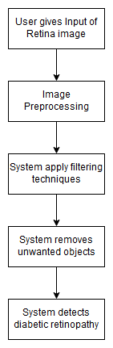
System Architecture

Slide 10
Modules
Image Preprocessing
Apply Algorithm
Detection of Diabetes

Slide 11
Advantages of Proposed System
User Friendly
Helps to detect diabetic retinopathy

Slide 12
Applications
Eye clinic
Hospital

Slide 13
Mathematical Model
Let ‘S’ be the system
S = {I, P, O}
Where,
I = {Input to the system. User gives Retina Image to the system for processing.}
P = {P1, P2, P3}
P1 = {Image Preprocessing}
P2 = {Apply Filtering Techniques, CNN}
P3 = {Detect Diabetes}
O = {User will get the Output. Whether the user has diabetes or not.}

Slide 14
Algorithm
CNN Convolution neural networks
A CNN consists of an input and an output layer, as well as multiple hidden layers.
The hidden layers of a CNN typically consist of convolutional layers, pooling layers, fully connected layers and normalization layers.
A CNN consists of an input and an output layer, as well as multiple hidden layers as:
1. Convolutional layer
2. Pooling layer
3. Activation Function layer
4. Fully connected layer
5. Loss layer.

Slide 15
Convolutional Layer:
The convolution layer is the main building block of a convolutional neural network. Convolutional layer is responsible for feature extraction of images.
Pooling Layer:
As convolutional layer extract the features from images, pooling layer is useful for extracting important features from convolved features.
There are two types of pooling as max pooling and average pooling.
In pooling, a window of 2*2 size is used to have a group of features. Pooling works on each group of features independently.
In max pooling, the maximum value among the features in a group is extracted. In average pooling, the average of each value in a group is calculated.

Slide 16
Activation Function Layer:
After pooling layer, important features are extracted from the images.
And after that again convolutional layer is applied. But range of output values of pooling layer has to be converted to 0 or 1 because next convolutional layer has to deal with this range.
That is why activation functions are necessary.
Fully Connected Layer:
The last layer of CNN is fully connected layer and it is also known as dense layer.
In fully connected layer each and every node is connected to each and every node from previous layer. The features extracted in convolutional and pooling layer are used in fully connected layer for classification applying classification algorithms.

Slide 17
System Requirements
Hardware Requirements:
System : Intel I3 Processor.
Hard Disk : 20 GB.
Monitor : 15 VGA Colour.
Ram : 4 GB
Software Requirements:
Operating system : Windows 7 and above.
Coding Language : Python
IDE : Spyder

Slide 18
Functional Requirements
Functional Specification:
The application is user friendly.
It provides an easy interface to user.
The accessibility or response time of the application should be fast.
Dependency and Constraints:
End User application will be developed for Windows OS Platform.
We use Spyder IDE for Project Development
We use retina’s thermal images as input.
All scripts/code shall be written in Python.
Application design pattern shall be Singleton.

Slide 19
Software Requirement Specification
Purpose and Scope of Document
A software requirements specification (SRS) is a document that is created when a detailed description of all aspects of the software to be built must be specified before the project is to commence. It is important to note that a formal SRS is not always written. In fact, there are many instances in which effort expended on a SRS might be better spent in other software engineering activities.
Overview of responsibilities of Developer
1. To have understanding of the problem statement.
2. To know what are the hardware and software requirements of proposed system.
3. To have understanding of proposed system.
4. To do planning various activities with the help of planner.
5. Designing, programming, testing etc.

Slide 20
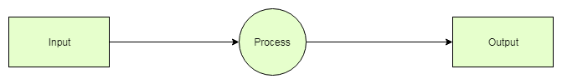
UML Diagrams
DFD Diagram Level 0

Slide 21
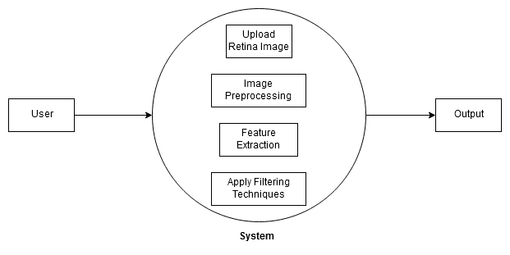
DFD Diagram Level 1

Slide 22
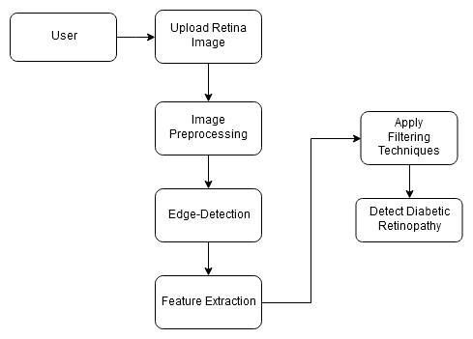
DFD Diagram Level 2

Slide 23
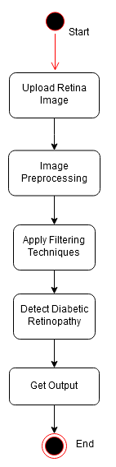
Activity Diagram

Slide 24
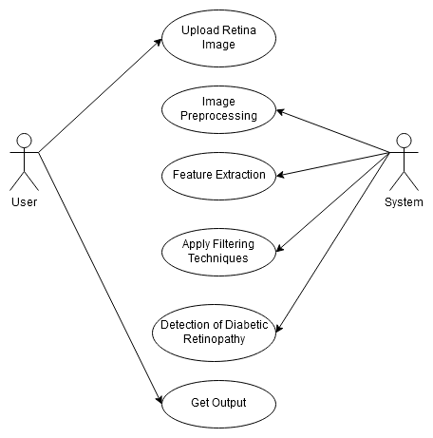
Use case Diagram

Slide 25
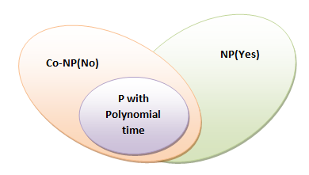
Problem NP Hard – NP Complete
What is P?
P is set of all decision problems which can be solved in polynomial time by a deterministic.
Since it can be solved in polynomial time, it can be verified in polynomial time.
Therefore P is a subset of NP.
P: If a person has Diabetes then it will get result as a reduction in health of that person. So early detection of diabetes is important which will help that person for further treatment.

Slide 26
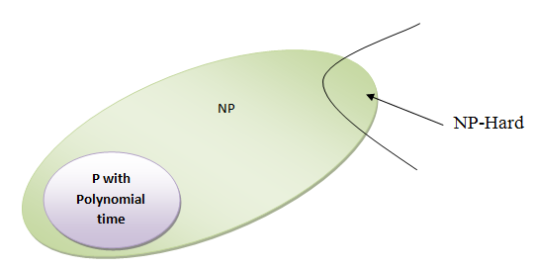
What is NP?
"NP" means "we can solve it in polynomial time if we can break the normal rules of step-by-step computing".
What is NP Hard?
A problem is NP-hard if an algorithm for solving it can be translated into one for solving any NP-problem (nondeterministic polynomial time) problem. NP-hard therefore means "at least as hard as any NP-problem," although it might, in fact, be harder.
NP-Hard:
We use CNN algorithm, epoch formula to increase system accuracy. For that we use Tensorflow machine learning framework.
So here in this case the ‘P’ problem is NP hard.
i.e. P=NP-Hard

Slide 27
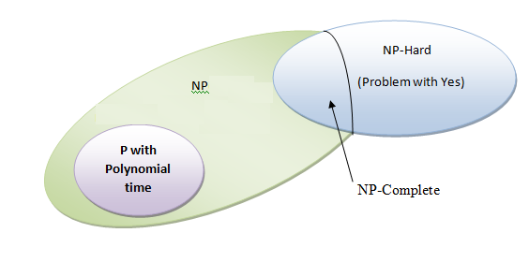
What is NP-Complete?
Since this amazing "N" computer can also do anything a normal computer can, we know that "P" problems are also in "NP".
So, the easy problems are in "P" (and "NP"), but the really hard ones are *only* in "NP", and they are called "NP-complete".
It is like saying there are things that People can do ("P"), there are things that Super People can do ("SP"), and there are things *only* Super People can do ("SP-complete").

Slide 28
NP-Complete:
To solve this problem, we use CNN algorithm for processing. In CNN system works in layer by layer system. We use Tensorflow framework for machine learning for training and testing data. We also use epoch formula to increase accuracy of our system. If we get accuracy > 90% then we will stop increasing accuracy of system.
Hence the ‘P’ is NP-Complete in this case.

Slide 29
Conclusion
Extracting blood vessels from retinal images help in early diagnosis of eye diseases. We are proposing automated system for extracting blood vessels from retinal images. System uses advanced image processing techniques including classification of image pixels into vessels or non-vessels and classification of retinal images into normal or abnormal. This helps in diagnosis of different types of eye disease.

Slide 30
References
[1] J. Shan and L. Li, “A Deep Learning Method for Microaneurysm Detection in Fundus Images,” in IEEE 1st International Conference on Connected Health: Applications, Systems and Engineering Technologies, CHASE 2016, 2016.
[2] M. Usman Akram et al., “Detection and classification of retinal lesions for grading of diabetic retinopathy,” Comput. Biol. Med., vol. 45, no. 1, pp. 161–171, 2014.
[3] J. Shlens, “A Tutorial on Principal Component Analysis,” ArXiv, pp. 1–13, 2014.
[4] Q. V Le, W. Y. Zou, S. Y. Yeung, and A. Y. Ng, “Learning hierarchical invariant spatio-temporal features for action recognition with independent subspace analysis,” in Computer Vision and Pattern Recognition, pp. 3361–3368, 2011.
[5] C.-C. Chang and C.-J. Lin, “Libsvm,” ACM Trans. Intell. Syst. Technol., vol. 2, no. 3, pp. 1–27, Apr. 2011.
[6] K. Ram, G. D. Joshi, and J. Sivaswamy, “A successive clutter-rejectionbased approach for early detection of diabetic retinopathy,” IEEE Trans. Biomed. Eng., vol. 58, no. 3, pp. 664–673, 2011.

Slide 31
Thank You

